Slide 1
IoT Army of 300
Resource Development to enable Our Brightest Minds in Technology
Abdur Rahman
Lecture 1
Introduction to Microcontroller
Oct 09, 2017

Slide 2





Control, Control, Control……..
Decide??
Jump/skip

Slide 3
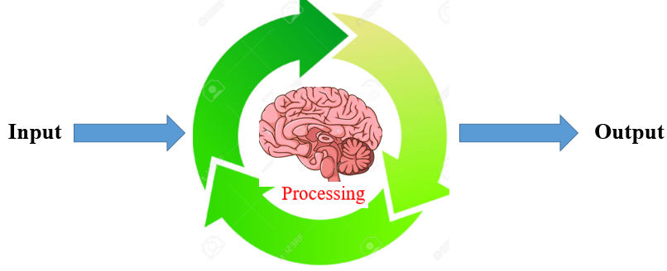
Controller??

Slide 4
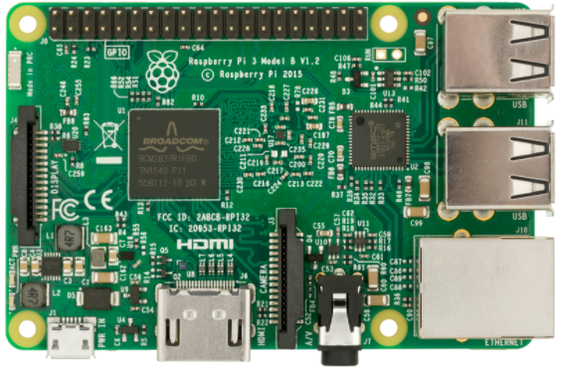
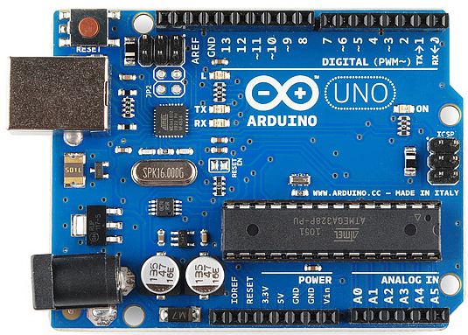
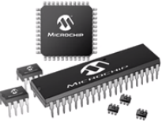
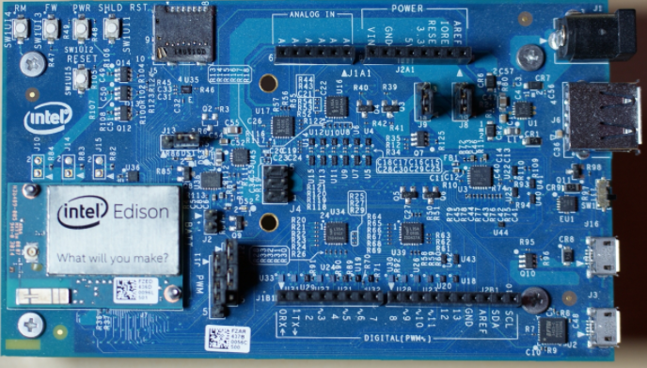
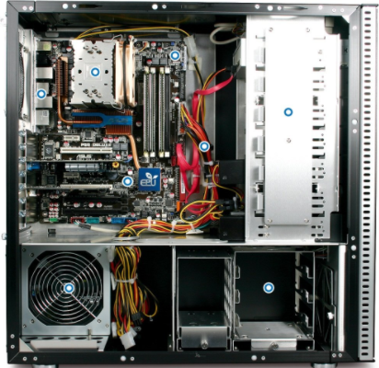
Controller?? ( Brain of the System )

Slide 5
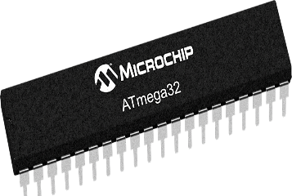
Single-Chip Computer
Known as Microcontroller
Don't require any external chips in order to function.
Are generally used in low-end embedded systems, such as touch-pad devices and industrial control systems.
Everything is packaged in the same single physical IC
CPU core(s)
Memory (ROM and RAM)
All the IO hardware

Slide 6
Single-board Computer
A single-board computer (SBC) is a complete computer built on a single circuit board, with microprocessor(s), memory, input/output (I/O) and other features required of a functional computer.
Raspberry Pi
Intel Edison
Arduino

Slide 7
Multi-Chip Computer
The CPU IC contains the CPU cores.
The Video GPU contains the video processor.
The RAM modules contain the RAM memory.
The BIOS chip contains the ROM memory.
The "chipset" contains the IO logic and bus interface logic
Traditional computers are Multi-Chip. Some of the most recent processors (some of the i series from Intel) include the video GPU in the processor IC, but they still require external chips in order to interface with the rest of the computer (PCI bridge, etc)

Slide 8
What is the best controller for IoT??
Microcontroller

Slide 9
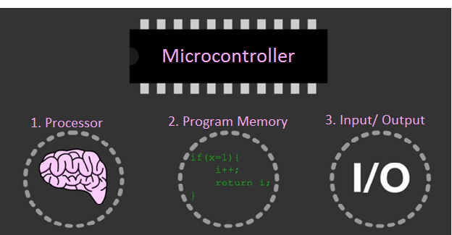
Microcontroller (MCU)
Microcontroller is a tiny size computer or single chip Computer which is dedicated to perform one task and execute one specific application. Microcontroller has variety of packages and sizes.
The fundamental components of MicroController Unit (or MCU)
Central Processing Unit(or CPU)
Memory (RAM, ROM)
programmable input/output peripherals.

Slide 10
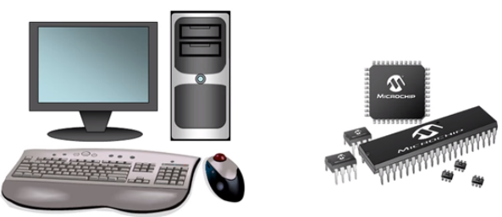
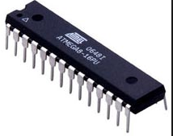
PC Vs MCU
PC | MCU(ATmega32)
Perform number of task simultaneously Example: Listening music, typing in a word processor, opening a fb messenger and etc at a time. | Typically dedicated to single task.
8GB RAM, 1 TB harddisk | 2KB RAM, 1 KB EEPROM, 32 KB Flash memory
2.2GHz processing speed | 16MHz maximum speed

Slide 11
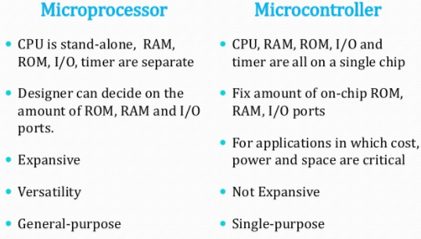
MPU Vs Microcontroller

Slide 12
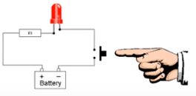
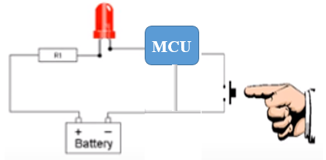
Where would I use a Microcontroller(MCU)?
Any where you would like to add intelligence…
Brainless System
Intelligent System

Slide 13
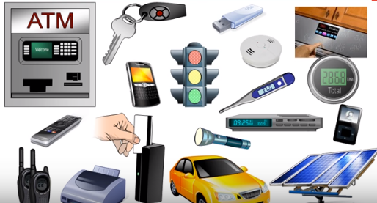
Where Microcontrollers are used??

Slide 14
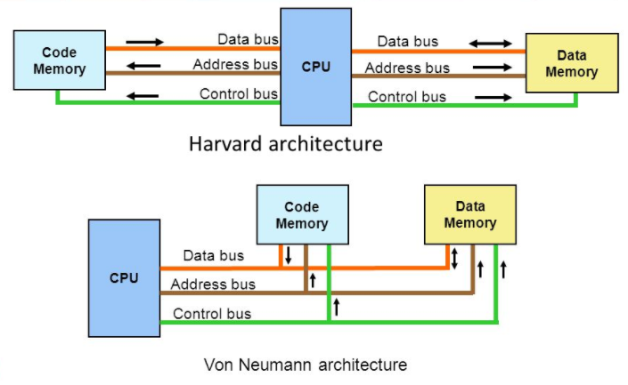
Types of MCU
The microcontrollers are characterized regarding bus-width, instruction set, and memory structure.
Bits (bus-width):
8 bits MCU
16 bits MCU
32 bits MCU
2. Memory:
External Memory MCU: used external program memory.
Embedded Memory MCU: The MCU that has all program & data memory, counters & timers, interrupts, I/O ports and therefore its embedded memory microcontroller.
3. Instruction Set:
CISC: CISC means complex instruction set computer, it allows the user to apply 1 instruction as an alternative to many simple instructions. reducing the number of instructions per program.
RISC: RISC means Reduced Instruction Set Computers. RISC reduces the operation time by shortening the clock cycle per instruction. reducing the clock cycles per instruction.
The RISC gives a better execution than the CISC.
4. Memory Architecture:
Harvard Memory Architecture Microcontroller
Von neumann Memory Architecture Microcontroller

Slide 15
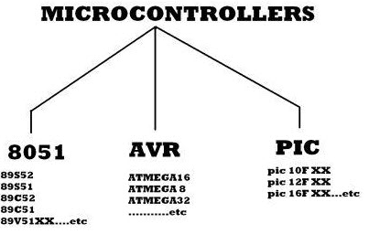
Different types of MCU
8051 Microcontroller:
The Intel MCS-51 (commonly termed 8051) is an internally Harvard architecture, complex instruction set computer (CISC) instruction set, single chip microcontroller (µC) series developed by Intel in 1980 for use in embedded systems. The two other members of this 8051 family are- 8052 & 8031
PIC Microcontroller:
Peripheral Interface Controller (PIC) provided by Micro-chip Technology to categorize its solitary chip microcontrollers. These appliances have been extremely successful in 8 bit micro-controllers. The foremost cause behind it is that Micro-chip Technology has been constantly upgrading the appliance architecture and included much required peripherals to the micro-controller to go well with clientele necessities. PIC microcontrollers are very popular amid hobbyists and industrialists; this is only cause of wide availability, low cost, large user base & serial programming capability.

Slide 16
Different types of MCU
AVR Microcontroller:
AVR also known as Advanced Virtual RISC, is a customized Harvard architecture 8 bit RISC solitary chip micro-controller. It was invented in the year 1966 by Atmel. Harvard architecture signifies that program & data are amassed in different spaces and are used simultaneously. It was one of the foremost micro-controller families to employ on-chip flash memory basically for storing program, as contrasting to one time programmable EPROM, EEPROM or ROM, utilized by other micro-controllers at the same time. Flash memory is a non-volatile (constant on power down) programmable memory.
Classification of AVR Controllers:
AVR Microcontrollers are classified into three types:
TinyAVR – Less memory, small size, suitable only for simpler applications
MegaAVR – These are the most popular ones having good amount of memory (up to 256 KB), higher number of inbuilt peripherals and suitable for moderate to complex applications
XmegaAVR – Used commercially for complex applications, which require large program memory and high speed

Slide 17
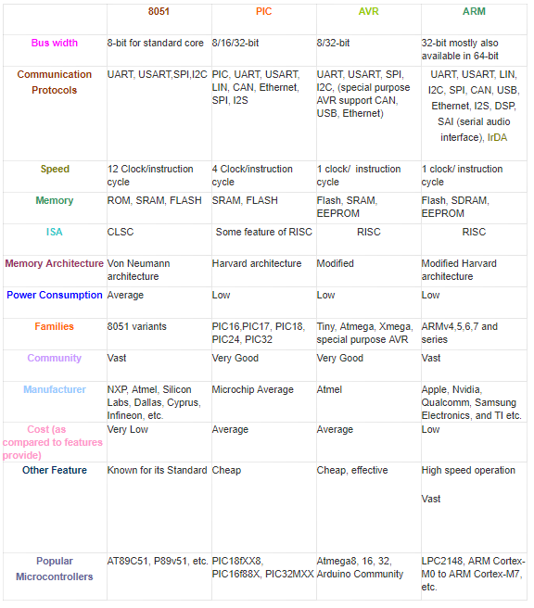
Main Difference between AVR, ARM, 8051 and PIC Microcontrollers

Slide 18
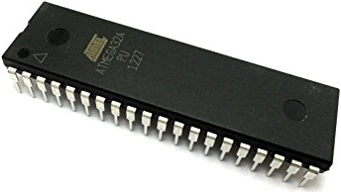
MCU Selection
There is so many difference between these micro-controllers. Differences based on there features, architecture, speed, cast, Memory, Power Consumption, Bus Width, peripheral etc.
ATmega32
ATmega32 is an 8-bit high performance microcontroller of Atmel's Mega AVR family.

Slide 19
Thanks

